Slide 1
Microservices Patterns

Slide 2
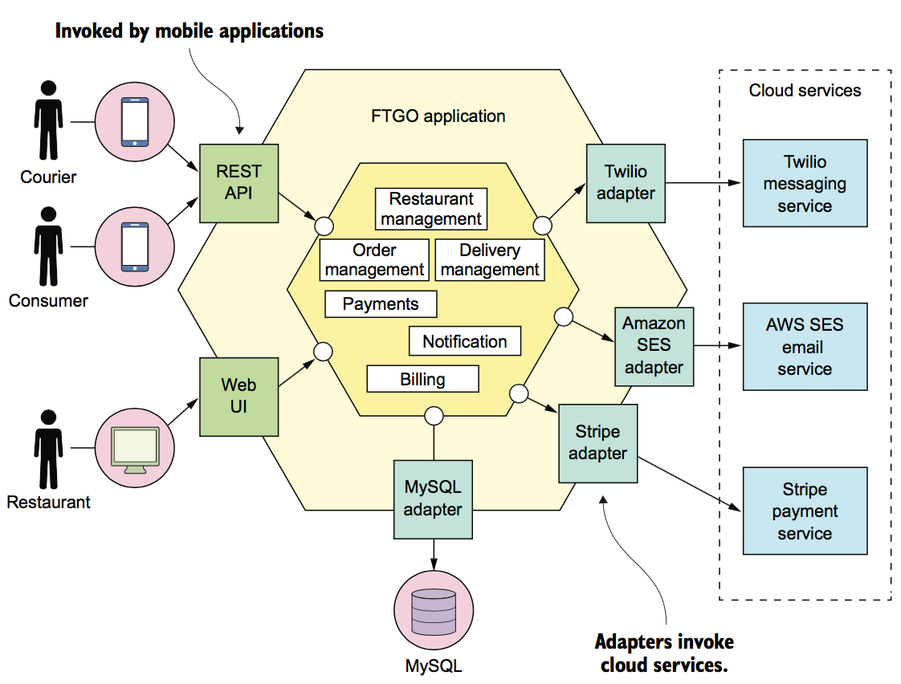
The architecture of the FTGO application
Notes:
Digital Well Program allows companies to plan, approve, and monitor each phase of the well construction process based on a company’s unique processes and business rules. The foundation of these workflows are created using DecisionSpace Business Process Management (BPM).
Since DWP is focused on guiding your end to end workflow it is imperative that you collect as much information as you can from the Company.
Such as their Processes, Structure, Workflows and Business Rules.
You will need this information to build the DWP workflows that meet the clients specific needs.

Slide 3
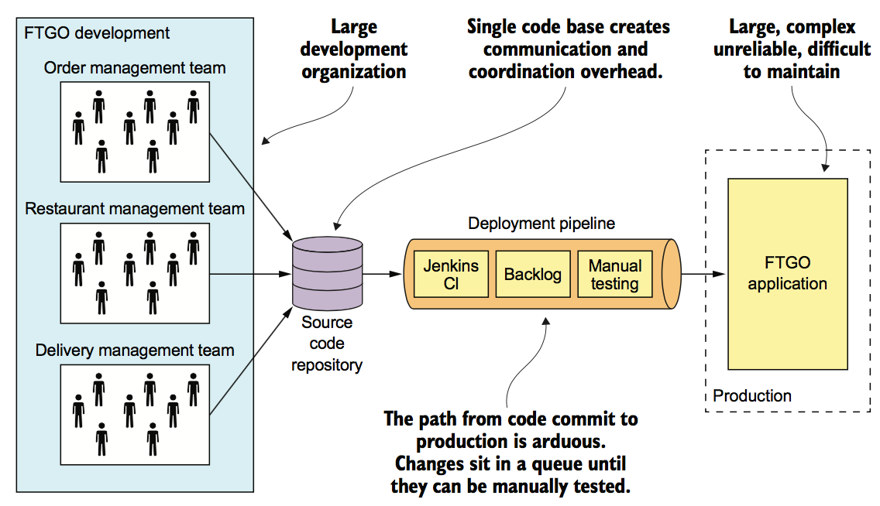
The slow march toward monolithic hell
Notes:
Digital Well Program allows companies to plan, approve, and monitor each phase of the well construction process based on a company’s unique processes and business rules. The foundation of these workflows are created using DecisionSpace Business Process Management (BPM).
Since DWP is focused on guiding your end to end workflow it is imperative that you collect as much information as you can from the Company.
Such as their Processes, Structure, Workflows and Business Rules.
You will need this information to build the DWP workflows that meet the clients specific needs.

Slide 4
The architecture of the FTGO application
Notes:
Digital Well Program allows companies to plan, approve, and monitor each phase of the well construction process based on a company’s unique processes and business rules. The foundation of these workflows are created using DecisionSpace Business Process Management (BPM).
Since DWP is focused on guiding your end to end workflow it is imperative that you collect as much information as you can from the Company.
Such as their Processes, Structure, Workflows and Business Rules.
You will need this information to build the DWP workflows that meet the clients specific needs.

Slide 5
The architecture of the FTGO application
Notes:
Digital Well Program allows companies to plan, approve, and monitor each phase of the well construction process based on a company’s unique processes and business rules. The foundation of these workflows are created using DecisionSpace Business Process Management (BPM).
Since DWP is focused on guiding your end to end workflow it is imperative that you collect as much information as you can from the Company.
Such as their Processes, Structure, Workflows and Business Rules.
You will need this information to build the DWP workflows that meet the clients specific needs.

Slide 6
The architecture of the FTGO application
Notes:
Digital Well Program allows companies to plan, approve, and monitor each phase of the well construction process based on a company’s unique processes and business rules. The foundation of these workflows are created using DecisionSpace Business Process Management (BPM).
Since DWP is focused on guiding your end to end workflow it is imperative that you collect as much information as you can from the Company.
Such as their Processes, Structure, Workflows and Business Rules.
You will need this information to build the DWP workflows that meet the clients specific needs.

Slide 7
The architecture of the FTGO application
Notes:
Digital Well Program allows companies to plan, approve, and monitor each phase of the well construction process based on a company’s unique processes and business rules. The foundation of these workflows are created using DecisionSpace Business Process Management (BPM).
Since DWP is focused on guiding your end to end workflow it is imperative that you collect as much information as you can from the Company.
Such as their Processes, Structure, Workflows and Business Rules.
You will need this information to build the DWP workflows that meet the clients specific needs.

